Slide 1

WCSD TITLE I DEPARTMENT
Presenters: Brian Prewett- Title I Director
Amber Hilberg- Title I Grant Coordinator
June 24, 2025

Slide 2

Title I Part A Improving the Academic Achievement of the Disadvantaged
SY 2024-25 Funding Allocation: $12,668,355
(Formula Grant)
District Eligibility:
Schools are selected based on the poverty level of students residing in each school’s “attendance zone” or geographic area from which the school draws its students.
Schools must be ranked and served in order of their relative percentages of low-income children, and federal regulations state that every school with a 75% or higher poverty rate must be served by the Title I program regardless of the school’s grade span.
For SY 2024-2025, WCSD served 52 K-12 schools, for SY 2025-2026 WCSD will serve 51 K-12 schools at 68.81% FRL (Free and Reduced Lunch) and above.
3

Slide 3
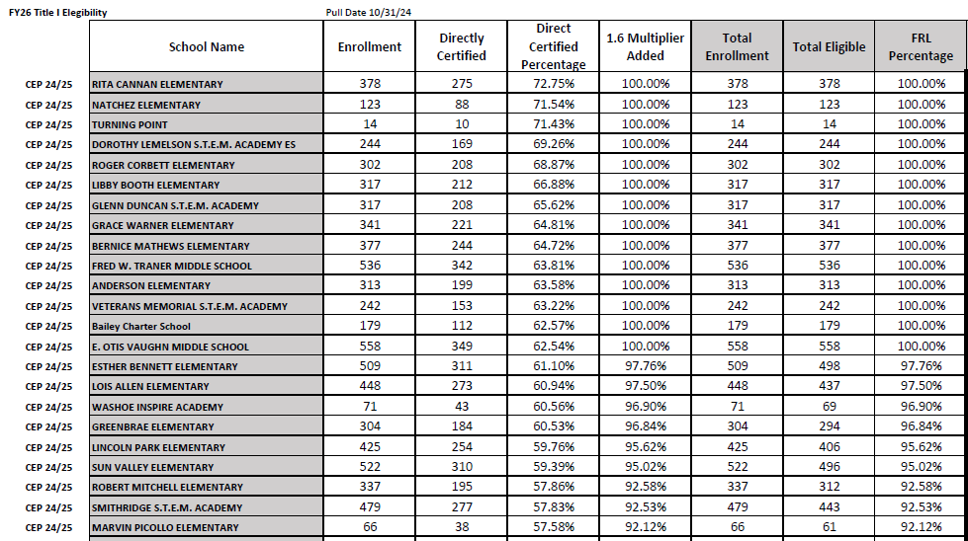
Title I Part A (cont.) Improving the Academic Achievement of the Disadvantaged

Slide 4

Title I Part A (cont.)
Improving the Academic Achievement of the Disadvantaged
Purpose: To supplement local education programs and help ensure that economically disadvantaged students are given the same opportunity to achieve state-defined academic standards as their more affluent peers.
Schools, districts, and states are held accountable for raising the academic performance of all students, narrowing the achievement gap between underachieving groups and their more advantaged peers, and enabling those most at risk to reach state academic standards.
General Compliance: WCSD is required to comply and provide documentation that all federal Supplement not Supplant and Comparability regulations are followed.
4

Slide 5
Title I Part A (cont.)
Improving the Academic Achievement of the Disadvantaged
Site-Based Allocations: Title I schools have the flexibility to use funds in ways they deem most likely to raise the academic performance of all students, narrow the achievement gap between underachieving groups and their more advantaged peers, and enable those most at risk to reach state academic standards including:
Hiring additional staff;
Professional development;
Purchasing computer equipment or other instructional materials;
Student supplies; and
Support for family and community engagement.
5

Slide 6



Questions?

